Slide 1
Leading and Managing as a new PIC
“Underwritten by The Jack & Priscilla Schlegel Endowed Leadership Development Fund”
Notes:
Brief intros and survey of audience

Slide 2
Alpha Psi Education, Scholarship & Leadership Foundation
Creating Tomorrow’s Leaders
The mission of the Alpha Psi Foundation, a 501 (c) (3) tax exempt public benefit corporation, is to provide scholarships and leadership development for men and women student pharmacists and new professionals. The Foundation funds eight scholarships annually and conducts leadership development programming.
Notes:
The Foundation embodies the belief that investing in the development of student pharmacists and new professionals is an investment in improving the profession of pharmacy and health of our communities.

Slide 4
LEADERSHIP 1) Discuss leadership challenges 2) Define your vision and values 3) Identify ways to create time 4) Illustrate how to make tough choices 5) Describe failing forward and growth
OBJECTIVES:
MANAGEMENT 1) Summarize strategies to manage thyself
2) List legal and regulatory requirements
3) Describe inventory requirements
4) Compare P&P&P and workflows
5) Discuss conflict management strategies

Slide 5
LEADERSHIP

Slide 6
Leadership Challenges
What will be your greatest challenge as a new PIC?
What is your 30/60/90 day plan?
What will be your guiding principles? What will you be remembered for?
Notes:
Discuss the many ‘hats’; leader, manager, office tech

Slide 7
Vision and Values
What will be your greatest challenge as a new PIC?
What is your 30/60/90 day plan?
What will be your guiding principles? What will you be remembered for? “If serving is beneath you, then leadership is beyond you”
Notes:
“The 7 Habits of Highly Effective People’ by Stephen Covey
Personal example: 30/60/90 days plan or quarterly plan; listening (not changing things for the sake of change; choosing your battles)

Slide 8
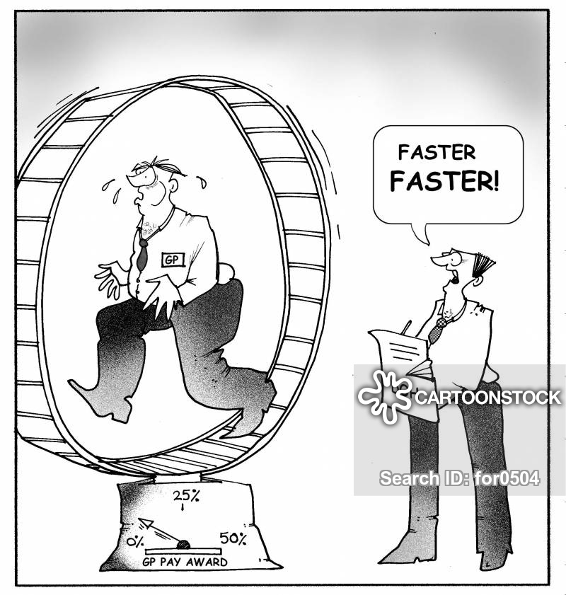
Creating Time
Give yourself and team permission (break free from the day-to-day)
Delete, delay (intentional procrastination), delegate, and automate
ROI/ROTI (return on investment; return on time invested)
Ask yourself; what can I do today that will make tomorrow better?
Notes:
‘Procrastinate on Purpose’ by Rory Vaden
Personal example; community/independent pharmacies (avoiding burnout)

Slide 9
Touch Choices & Growth Culture
Reflect back to your vision and values
Understanding conversations; creating buy-in, power questions (AAAE)
Creating a growth culture starts with you -Admit mistakes; be vulnerable and build trust -Conflict is okay; the relationships between conflict and creativity -Training and development; creating a shared language (e.g. ‘your job is not your job’)
“No quality or characteristic is more important than trust. Trust is the foundation for building a team.” Patrick Lencioni
Notes:
References:
-’The Four Conversations: Daily Communication That Gets Results’ by Jeffrey Ford
-’Conscious Business’ by Fred Kofman OR ‘Your Job is Not Your Job’ and ‘Be A Player; Not a Victim’ Linkedin video series
-’Power Questions: Build Relationships, Win New Business, and Influence Others’ by Andrew Sobel and Jeold Panas
Discussion point: if you create that right culture, then you take some pressure off of yourself (e.g. what do you think; given A,B,C, how would you..)

Slide 10
MANAGEMENT
Notes:
Personal example: CVS (over managing), state (over leading)

Slide 11
“A man should first direct himself in the way he should go, only then should he instruct others.” -Buddha

Slide 12
Managing Yourself
Maxwell’s ‘Law of the Lid’
Speed vs. Efficiency
Get Organized; you cannot be efficient or prioritize if you aren’t organized
PRIORITIZE; Eisenhower Matrix
Documentation and Filing (readily retrievable)
AUTOMATE; “a bad process will beat a good person every time”
“What is important is seldom urgent, and what is urgent is seldom important.” -34th US President Dwight D. Eisenhower
Notes:
The Law of the Lid states that “leadership ability is the lid that determines a person's level of effectiveness. The lower an individual's ability to lead, the lower the lid on his potential.
Reminder: give yourself permission to do those important things; what can I do today or now to make tomorrow better?

Slide 13
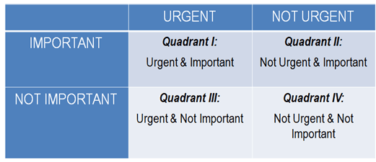
Matrix
Notes:
Popularized by Stephen Covey’s ‘7 Habits’
Discuss personal organization technique; one note for daily/weekly, excel for long-term projects/roll-outs, outlook for meetings, team or long term delayed tasks

Slide 14
Regulators
BOP (California Code of Regulations, Business Professions Code)
DEA (enforce ‘The Controlled Substance Act’)
FDA (The Drug Supply Chain Security Act; issue recalls)
EPA (RCRA: The Resource Conservation Recovery Act; hazardous waste)
USP, The Joint Commission
CDPH (Title 22, Licensed Beds)

Slide 15
Resources
https://www.pharmacy.ca.gov/laws_regs/lawbook.pdf
https://www.pharmacy.ca.gov/publications/inspections_brochure.pdf
https://www.pharmacy.ca.gov/laws_regs/1715_65_inv_rec_rpt_faq.pdf
https://www.dca.ca.gov/webapps/pharmacy/subscribe.php
Regulations, BOP minutes and publications
Company resources, personnel, legal
Who are your mentors and go-to resources?
Notes:
AAAE

Slide 16
PIC: The 1st 30 days
CCR 1715: Self-Assessment(s) within 30 days (before July 1 of every odd-numbered year)
https://www.pharmacy.ca.gov/licensees/facility/self_assess.shtml
CCR 1715.65: Inventory Reconciliation of CIIs within 30 days (quarterly thereafter)
Review licenses (pharmacy, DEA registration, personnel, ADDS)
Regulatory binder review and upkeep

Slide 17
Inventories
CFR 1304.11: Inventory of all controlled substances every 2 years
CCR 1715.65: Physical exact count and recon of scheduled II CS every 3 months
Theft or Loss: Any controlled substances drug loss is reported within one business day of discovery to the DEA (DEA Form 106) and within 30 days of discovery to the Board of Pharmacy. (21 CFR 1301.74[c], CCR 1715.6) [14 days if drug theft, self-use or diversion by a board licensee]

Slide 18
Inspections
https://www.pharmacy.ca.gov/publications/inspections_brochure.pdf
BOP’s goal is to inspect each pharmacy once every four years
Regulatory binders (licenses, registrations, personnel, theft/loss forms, quality assurance (medication errors), self assessments, inventories, power of attorneys, policy and procedures, previous inspections, waivers (COVID)
Recent common findings: clean and orderly pharmacy, hot and cold running water, interpretive services, display of licenses and required posters, safe and secure pharmacy, compounding, patient consultation, self-assessments, inventories and inventory recon
Policy and procedures; not protocols and workflows
Communicating with inspectors
Notes:
Inspector may issue an order of correction, citation, letter of admonishment, or institute a disciplinary proceeding
Discuss the purpose, tone, and goal (respectful, not defensive, cooperative, be concise and focused i.e. don’t invite further inspection; same team)

Slide 19
Performance Management
Clear is kind; set and clarify your expectations; preventative measures
Be specific, objective, timely (resolve early), avoid generalizations (e.g. never or always)
Recognition; the ultimate ROI
Managing the unmanageable (DISC reference & caveat)
Performance conversations (what, when and ‘yes’)
-Provide resources and the why
Notes:
Personal example; set expectation, be clear, concise and quick, not personal, even-handed then ‘move on’ ‘clock off’ and back to business. The unmanageable will provide more ‘ammo’, you continue to hold to your expectations, accountability, and fair standards.

Slide 20
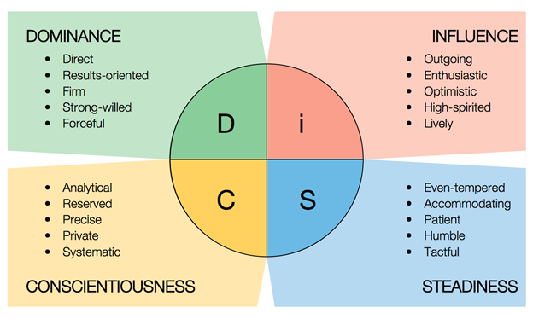
“DiSC”
Adapted from DiSCprofile.com

Slide 21
Q&A

